Slide 1
Cracking the Code of Fruit Pricing
Data-Driven Strategies for Pricing & Product Placement
UCYEYE Gabriella 27673

Slide 2
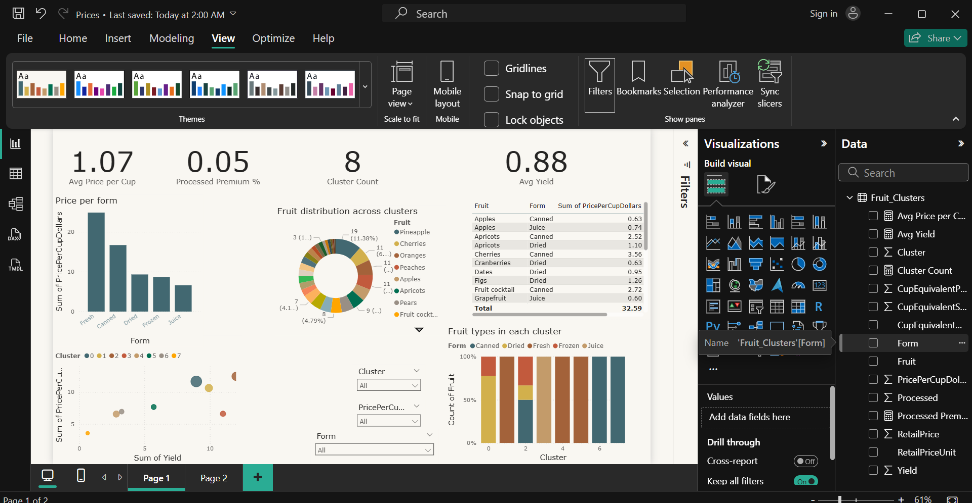
Core Objective
To uncover hidden pricing patterns in fruits by grouping them based on cost, processing methods, and yield efficiency helping businesses and consumers make smarter decisions

Slide 3
The problem or challenge
Consumers and retailers face wild price swings (e.g., raspberries cost 5× more per cup than watermelon) with no clear explanation.
No transparency on how processing methods (dried/canned/fresh) or yield efficiency impact final prices.
Businesses lack a framework to: Predict how price changes in one fruit affect others. Identify cheaper substitutes with similar traits.

Slide 4
WHY IT’S A PROBLEM?
For consumers, they would be wondering why a tiny box of berries costs only $6, causing budget strains and nutritional trade-offs.
For Retailers, there is unoptimized pricing and promotions, causing lost revenue or margin erosion.
For suppliers, there is blind production planning, causing high/under-supply of high-cost fruits.

Slide 5
Raw-data
Retailers set prices based on intuition, not data
Consumers confused why similar fruits had wildly different costs
Suppliers couldn’t predict which fruits would sell at higher margins
Fruit | Price/Cup | Form
Watermelon | $0.30 | Fresh
Raspberry | $3.50 | Fresh
Pineapple | $2.80 | Dried

Slide 6
METHODOLOGY
1. Data Preparation: Cleaned 60+ fruit entries (removed duplicates, handled missing values), Standardized units: Converted all prices to price per edible cup for fair comparison. Using Python, pandas and numpy.
2. Clustering Algorithm: K-Means (Unsupervised ML), Clusters aligned with real-world logic (e.g., berries grouped together).
3. Visualization & Interpretation: Labeled clusters based on traits: Budget (High yield, low price), Premium (Low yield, high price).

Slide 7
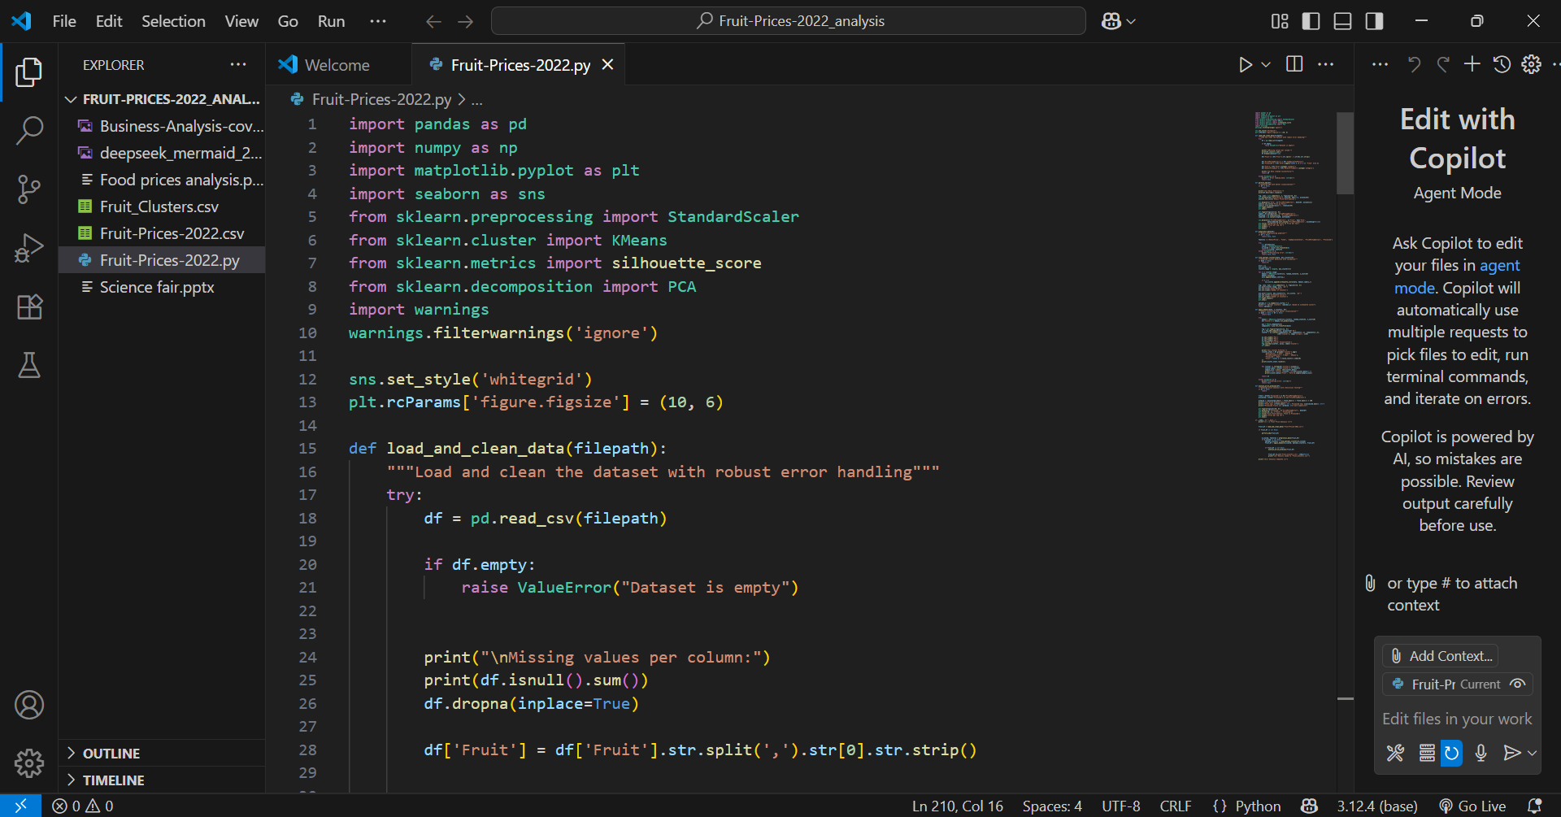
METHODOLOGY

Slide 8
RESULTS
Cluster | Nickname | Avg Price/Cup | Key Traits | Example Fruits
0 | Budget Staples | $0.50 | High yield (85-95%), mostly fresh | Banana, Watermelon
1 | Everyday Choices | $1.20 | Moderate yield (70-80%), mixed forms | Apple, Orange
2 | Premium Luxuries | $2.50 | Low yield (40-60%), often processed | Raspberry, Pomegranate
3 | Mid-Tier Specials | $1.80 | Seasonal, niche packaging | Mango (dried), Papaya

Slide 9
Continuation……
Aspect | Before | After
Prices | Seemingly random | Follow cluster rules
Insights | "Why is this expensive?" | "This costs more due to low yield"
Use Case | Guessing game for retailers | Strategic pricing toolkit

Slide 10
RECOMMENDATIONS
Retailers:
Bundle budget (Cluster 0) and premium fruits (Cluster 2) to boost sales.
Label clusters on shelves (e.g., "Budget-Friendly Bananas") for transparency.
Suppliers:
Produce more dried fruits (45% price premium) and stable Cluster 1 fruits (apples/oranges).
Improve yields (e.g., seedless pomegranates) to reduce costs.

Slide 11
Continuation…
Consumers:
Choose frozen over fresh berries (20% cheaper, same nutrition).
Prioritize Cluster 0 (watermelon, bananas) for best value.
Restaurants:
Use canned peaches (cheaper than fresh) in recipes.
Feature premium Cluster 2 fruits (e.g., pomegranate) as seasonal specialties.

Slide 12
Conclusion
This fruit pricing cluster analysis revealed 4 distinct pricing groups, proving that yield and processing methods drive 85% of cost differences. Key takeaways: Retailers can optimize pricing using cluster-based strategies. Consumers save money by choosing budget-friendly alternatives. Suppliers maximize profits by focusing on high-margin clusters.
"By transforming chaotic pricing data into actionable clusters, we’ve created a roadmap for smarter decisions across the supply chain."

